Slide 1
Data Analysis: Sales Prospects from Home Mortgage Data

Slide 2
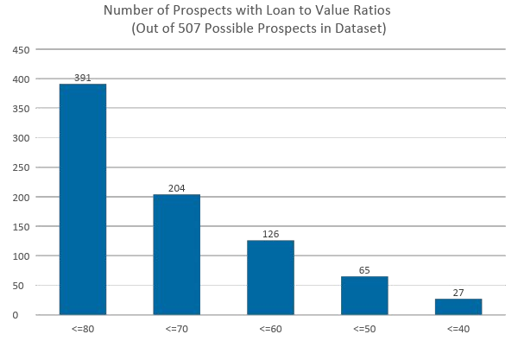
77% of borrowers in the dataset have loan-to-value ratios of 80 or less.

Slide 3
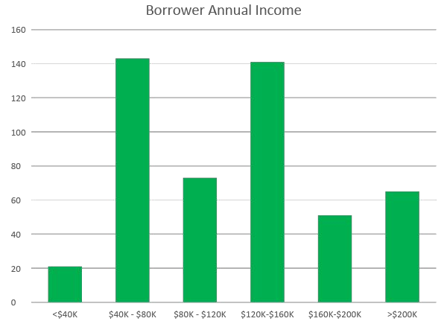
Annual incomes show a wide range of variation, possibly reflecting an imperfect sampling of target area mortgages when the dataset was constructed.

Slide 4
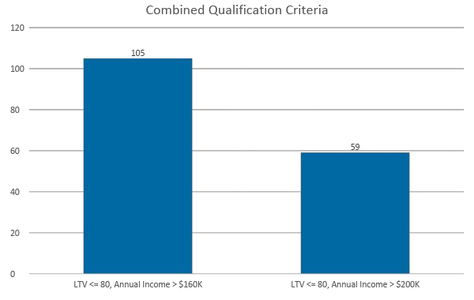
Combining LTV and annual income criteria generates 59 qualified, high income sales prospects.

Slide 5
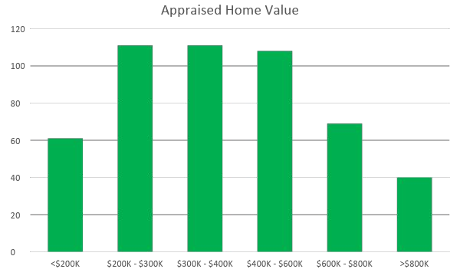
Appraised home values appear to be normally distributed in the dataset, with an average home value of approximately $430K.

Slide 6
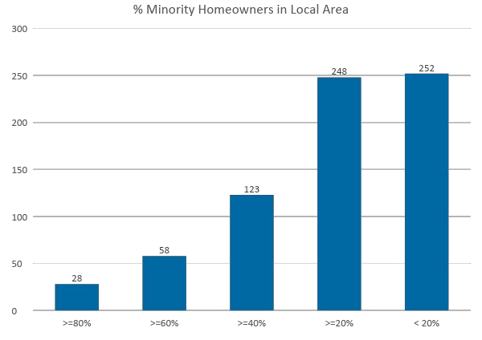
There are 85 borrowers in locations with a minority population greater than 50% in the dataset, representing potential targets for community outreach and support.

Slide 7
Observations and Key Insights
77% of borrowers in the dataset have loan-to-value ratios of 80 or less.
Annual incomes show a wide range of variation, possibly reflecting an imperfect sampling of target area mortgages when the dataset was constructed.
Combining LTV and annual income criteria generates 59 qualified, high income sales prospects, which is just under 12% of the total borrowers in this dataset.
Home values appear normally distributed with an average of about $430K.
There are 85 borrowers in locations with a minority population greater than 50% in the dataset, representing potential targets for community outreach and support.

